Slide 1
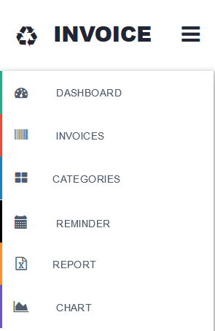
Invoice Management
Group 3
Notes:
Course Review Committee:
Review Date:

Slide 2
Mentor: Vu Dao
Group members:
Ngo Lam
Nguyen Cong Luat
Huynh Luu Quoc Linh
Nguyen Duc Tien
Ta Hong Bao Thai

Slide 3
Introduction
Invoice management is a web application for managing private finance.
It includes following main features:
Creating, editing an invoice category.
Creating, editing, removing an invoice.
Reporting a kind of invoices by certain criteria (day, month, year)
Alerting mechanism : Amount of money of certain invoice exceed.
Reminding mechanism: Which invoice need to pay by day.

Slide 4
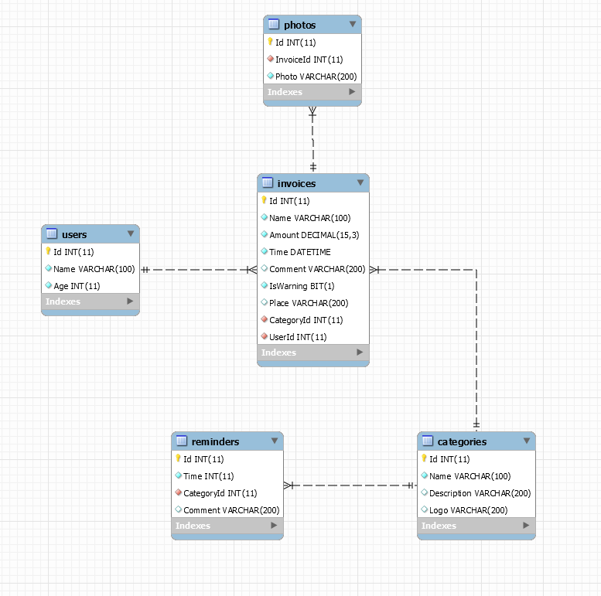

Slide 5
Activity Diagram

Slide 12








Technologies

Slide 13







Slide 14
Demo

